Slide 1
Business Process Engineering
Advance Business Process Modeling
Lecture: 06
Instructor: Salman Ahmad

Slide 2
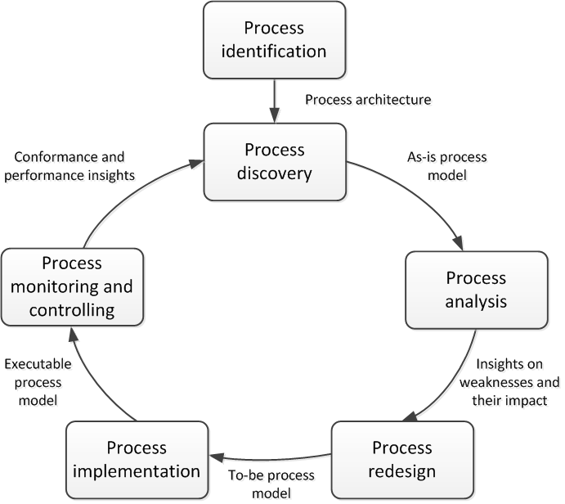
Business Process Lifecycle

Slide 3
BPMN Main Elements - Recap
Flow Objects
Connections
Pools & lanes
Artifacts
Data Store

Slide 4
BPMN Gateways
Exclusive (XOR)
Exclusive decision take one branch
Exclusive merge Proceed when one branch has completed
Parallel (AND)
Parallel split take all branches
Inclusive (OR)
Inclusive decision take one or several branches depending on conditions
Inclusive merge proceed when all active incoming branches have completed
Parallel join proceed when all incoming branches have completed

Slide 5
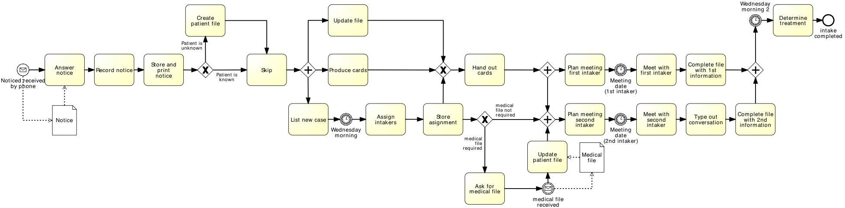
Exercise: critique the following model

Slide 6
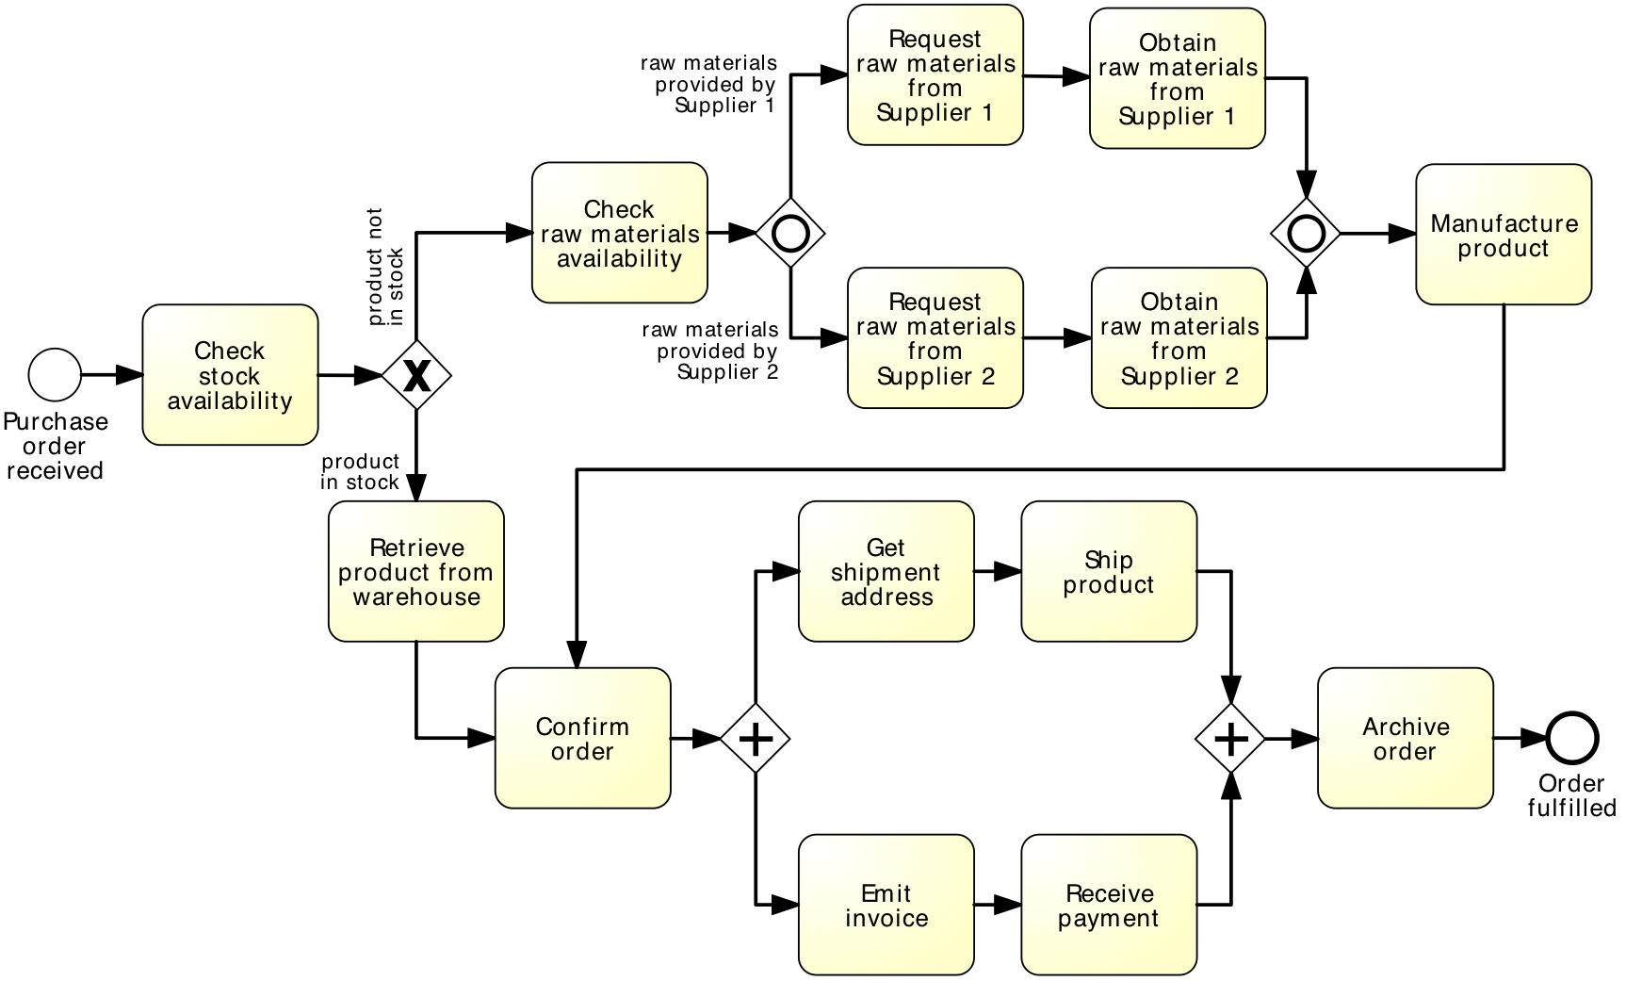
Anything wrong with this model?

Slide 7
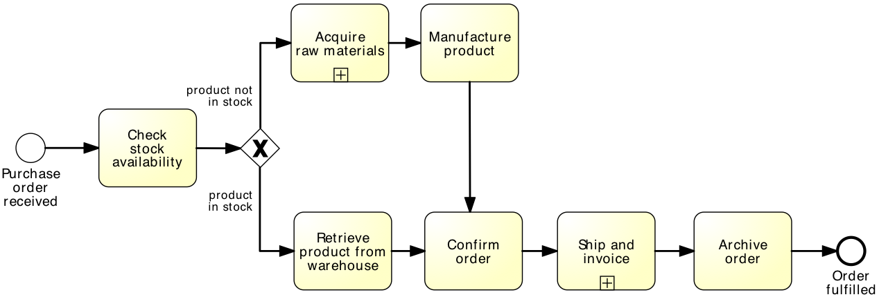
Is this better?

Slide 8
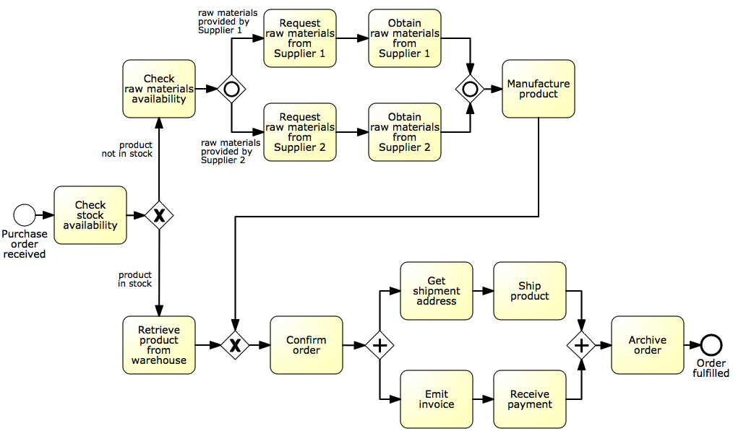
Identifying sub-processes
Acquire raw materials
Ship and invoice
Notes:
This is a more detailed version of our order-to-cash process where we added a branch to manufacture the product in case it is not in stock, and have made the shipment and invoicing part more detailed by asking for a shipment address and receiving the payment

Slide 9
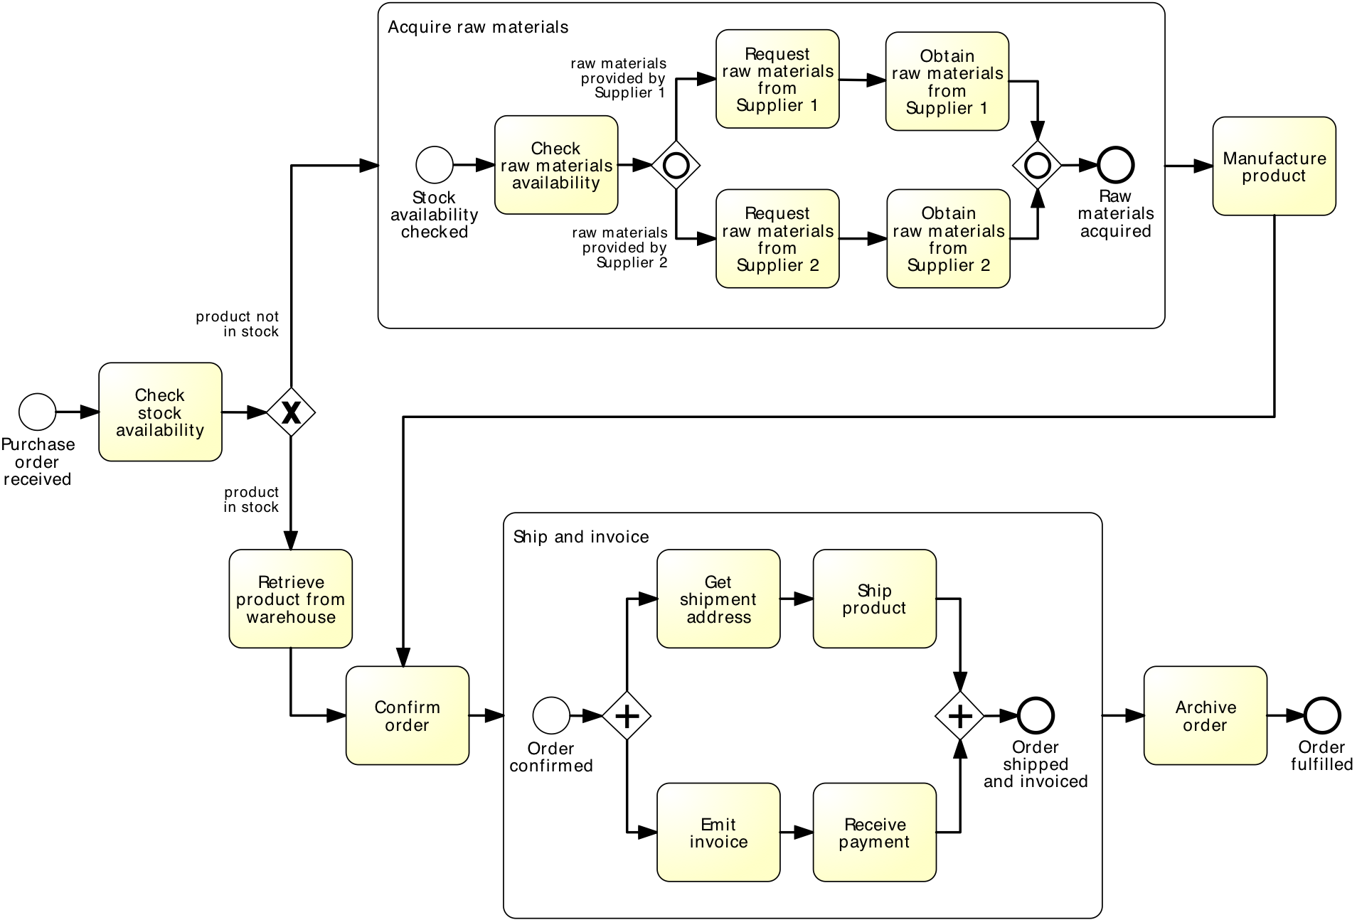
Expanded Sub-Process Notation

Slide 10
Sub-processes
An activity in a process can invoke a separate sub-process
Use this feature to:
Decompose large models into smaller ones, making them easier to understand and maintain

Slide 11
Guideline: Multi-level modeling
Level 1: value chain
Simple linear description of the phases of the process
No gateways
Each activity chain is a sub-process
Level 2+: expand each activity in the value chain, add incrementally the following:
Decisions, handoffs (lanes, pools)
Parallel gateways, different types of events
Data objects & data stores
And as much detail as you need, and no more

Slide 12
Guideline: Multi-level modeling (cont.)
At each level, decompose according to:
Logical milestones towards achieving the outcome of the process
Major objects used in the process
Decompose until processes are of “reasonable” size
e.g. up to 20 nodes (tasks+events+gateways) per model

Slide 13
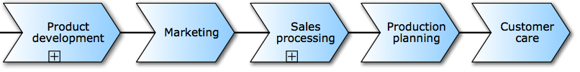
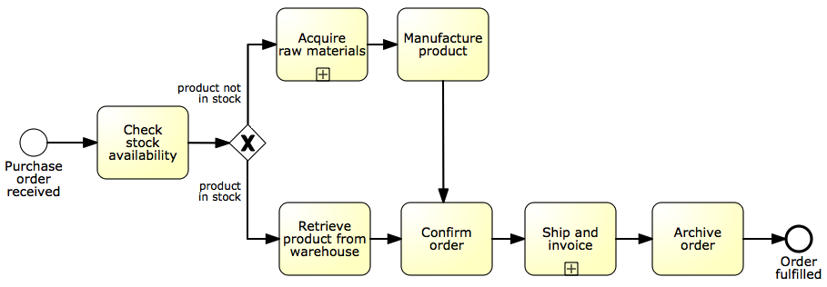
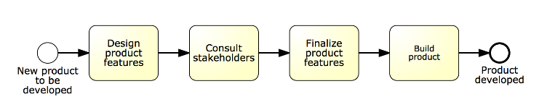
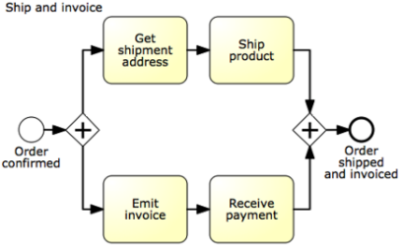
Non-BPMN value chain “chevron” notation
Collapsed process model

Slide 14
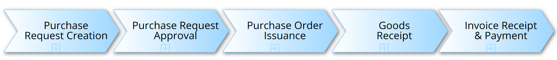
Value chain with sub-processes

Slide 15
Sub-processes
An activity in a process can invoke a separate sub-process
Use this feature to:
Decompose large models into smaller ones, making them easier to understand and maintain
Share common fragments across multiple processes

Slide 16
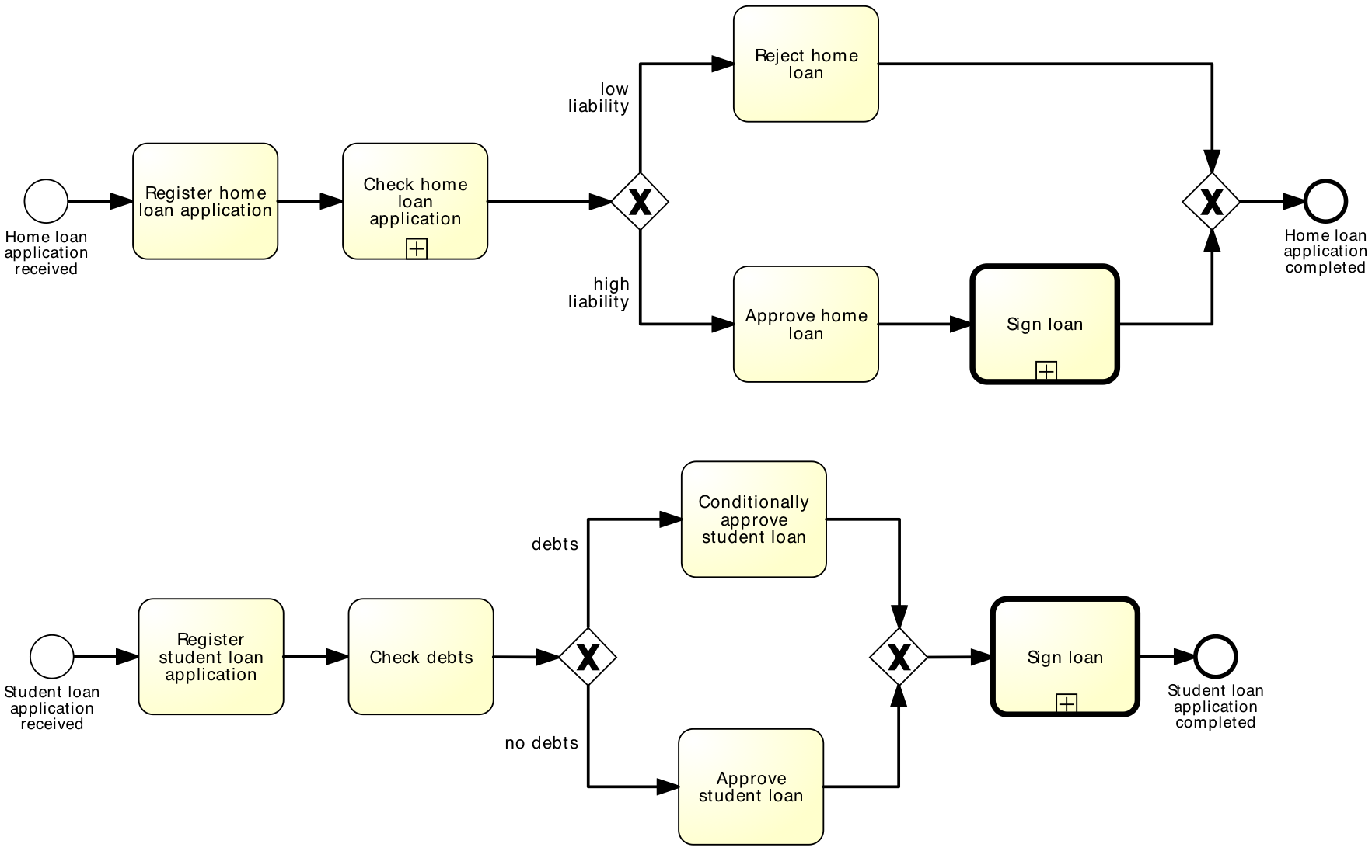
Shared sub-process

Slide 17
Sub-processes
An activity in a process can invoke a separate sub-process
Use this feature to:
Decompose large models into smaller ones, making them easier to understand and maintain
Share common fragments across multiple processes
Delimit parts of a process that can be:
Repeated
Interrupted

Slide 18
Structured Repetition

Slide 19
Block-structured repetition: Activity loop
Activity loop markers allow us to state that a task or a sub-process may be repeated multiple times
Notes:
In the previous lecture we introduced a mechanism for modeling rework and repetition by means of cycles: a repetition block starts with an XOR-join (entry point) and completes with an XOR-split (exit point)
Denoted with a circular arrow marker

Slide 20
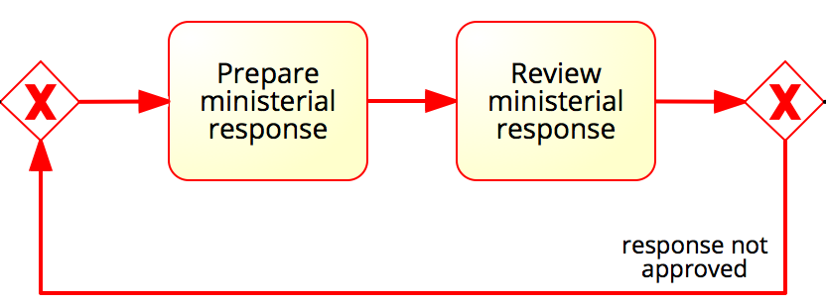
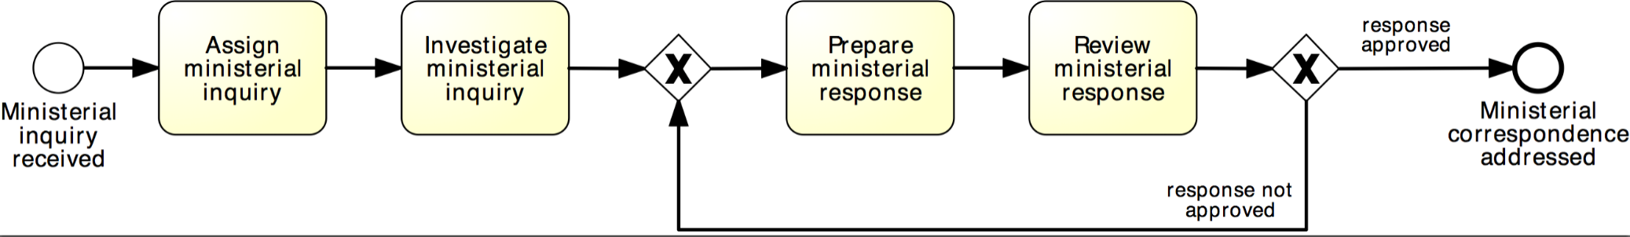
More on rework and repetition
XOR-join: entry point
XOR-split: exit point
Structured cycle
Notes:
So far we have learnt how to model cycles. A cycle is a flow that goes back to an “earlier” point of the process. It is used to model parts of the process that can be repeated.

Slide 21
Example: block-structured repetition
Completion condition
Must have a decision activity
Notes:
The advantage of using activity loops is that the size of the model can be sensibly reduced, as the details of the repetition block are hidden inside the collapsed sub-process

Slide 22
Parallel repetition: multi-instance activity
The multi-instance activity provides a mechanism to indicate that an activity is executed multiple times concurrently
Useful when the same activity needs to be executed for multiple entities or data items, such as:
Request quotes from multiple suppliers
Check the availability for each line item in an order separately
Send and gather questionnaires from multiple witnesses in the context of an insurance claim
Notes:
Denoted with a three-vertical lines marker

Slide 23
Example: multi-instance activity
Procurement:
In procurement, typically a quote is to be obtained from all preferred suppliers (assumption: five preferred suppliers exist). After all quotes are received, they are evaluated and the best quote is selected. A corresponding purchase order is then placed.

Slide 24
Solution: without multi-instance activity
Procurement

Slide 25
Solution: with multi-instance activity
Procurement
cardinality

Slide 26
Events

Slide 27
Events
In BPMN, events model something instantaneous happening during the execution of a process
Types of event:
Start
Intermediate
End
Notes:
Let’s take a step back and see how we can handle events in BPMN
They affect the process flow in three ways

Slide 28
BPMN event types
Notes:
So far we have seen these events

Slide 29
Comparison with sending/receiving tasks
=
=
=
≠

Slide 30
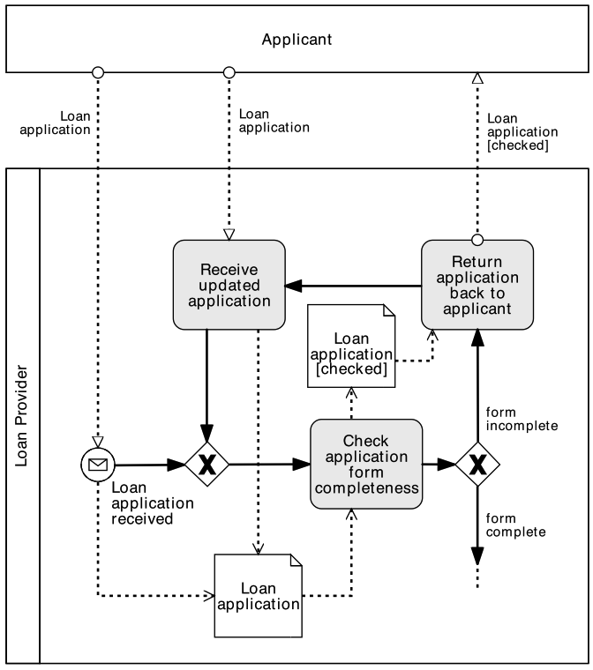
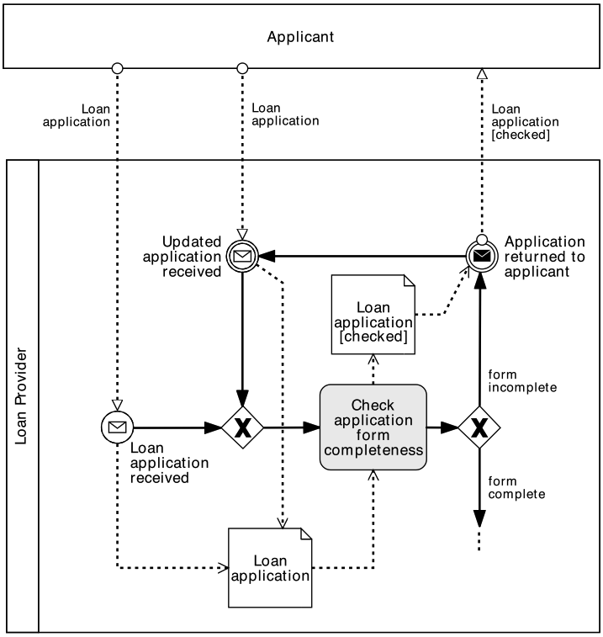
So, when to use what?
Use message events only when the corresponding activity would simply send or receive a message and do nothing else

Slide 31
Temporal events

Slide 32
Example
PO handling
A Purchase Order (PO) handling process starts when a PO is received. The PO is first registered. If the current date is not a working day, the process waits until the following working day before proceeding. Otherwise, an availability check is performed and a PO response is sent back to the customer.
Notes:
Point to the fact that the PO response needs to be prepared and this is what the last activity does.

Slide 33
Recap: Message and Timer events
Notes:
We should always specify the type of an event when this is known, as this improves the understanding of the model but does not increase its complexity/size

Slide 34
Data-based vs. event-based choices
In an XOR-split gateway, one branch is chosen based on expressions evaluated over available data
Choice is made immediately when the gateway is reached
Sometimes, the choice must be delayed until something happens
Choice is based on a “race between events”
BPMN distinguishes between:
Exclusive decision gateway (XOR-split)
Event-based decision gateway
Notes:
See “exclusive choice” pattern: http://www.workflowpatterns.com/patterns/control/basic/wcp4_animation.php
See “deferred choice” pattern: http://www.workflowpatterns.com/patterns/control/state/wcp16.php

Slide 35
Event-based decision
With the XOR-split gateway, a branch is chosen based on conditions that evaluate over available data
→ The choice can be made immediately after the token arrives from the incoming flow
Sometimes, the choice must be delayed until an event happens
→ The choice is based on a “race” among events
Two types of XOR split:
data-driven XOR-split
event-driven XOR split
Notes:
What we saw in the previous lecture is called “data-driven” XOR-split, as opposed to the “event-driven” XOR-split
Talk about the symbol: a diamond marked with an intermediate catching event whose symbol is an empty pentagon

Slide 36
Choices outside our control…
Stock replenishment
A restaurant chain submits a purchase order (PO) to replenish its warehouses every Thursday. The restaurant chain’s procurement system expects to receive either a “PO Response” or an error message. However, it may also happen that no response is received at all due to system errors or due to delays in handling the PO on the supplier’s side. If no response is received by Friday afternoon or if an error message is received, a purchasing officer at the restaurant chain’s headquarters should be notified. Otherwise, the PO Response is processed normally.

Slide 37
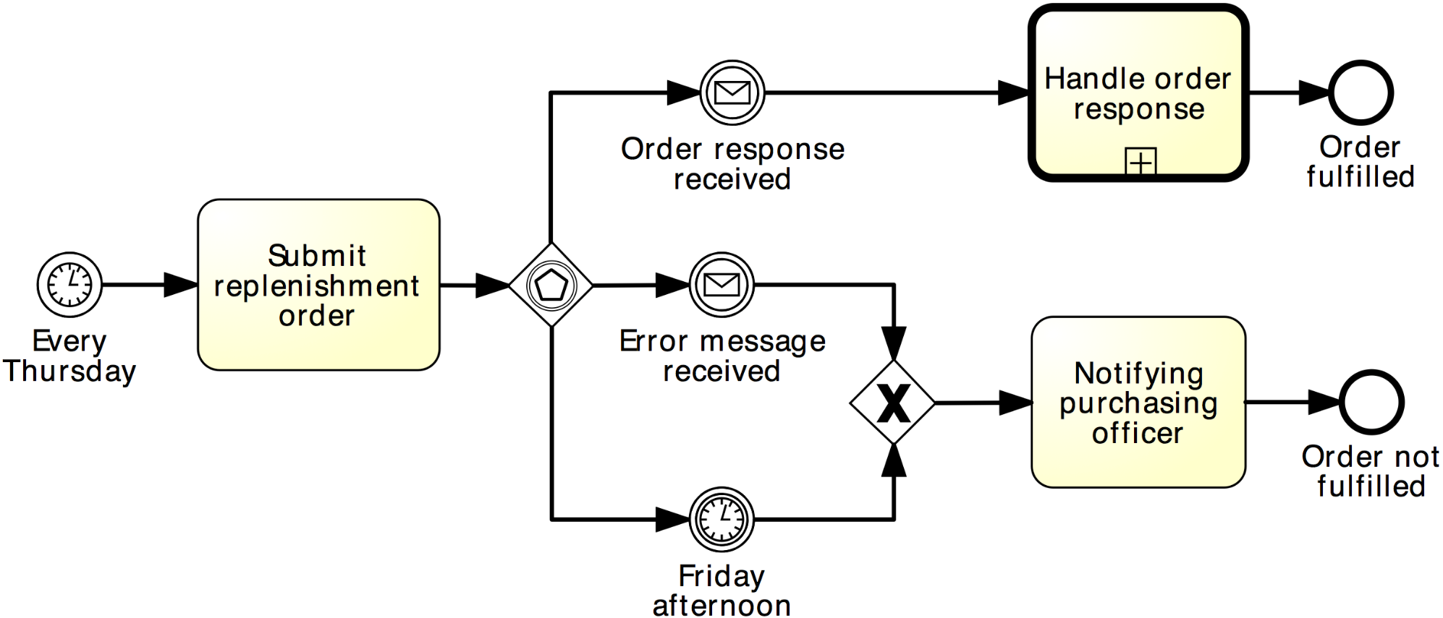
Solution: event-driven XOR split
Stock replenishment

Slide 38
Exception handling

Slide 39
Abortion (terminate event)
Exceptions are events that deviate a process from its “normal” course
The simplest form of exception is to notify that there is an exception (negative outcome)
This can be done via the Terminate end event: it forces the whole process to abort (“wipes off” all tokens left behind, if any)
Notes:
Provide examples of exceptions (business faults, technology faults)
An exception is not handled, leading to a negative outcome. For example the order is cancelled, or the product is discontinued. The negative outcome is that the order isn’t fulfilled

Slide 40
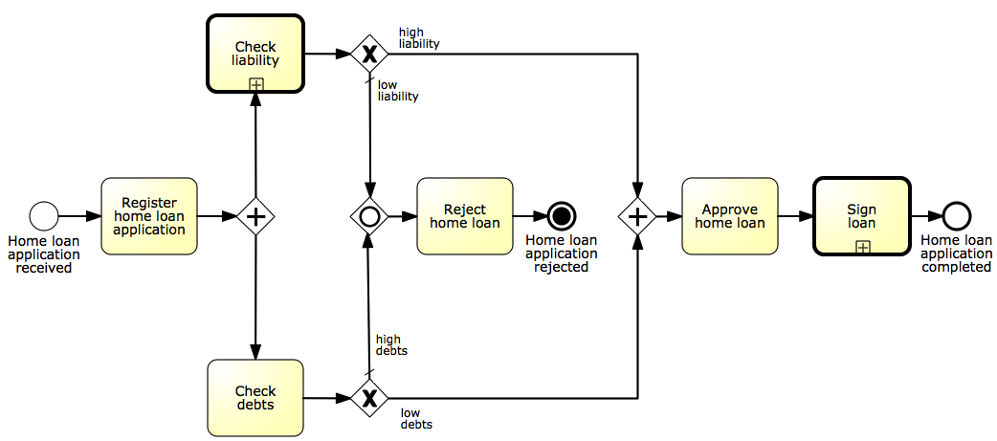
Example 2: terminate event
Abort the process by removing all tokens…
Notes:
This is a variant of the home loan application that we saw before, which includes checking for both liability and debts.
Approved only if no debts and high liability.
Rejected in all other cases: low liability, debts or both.
OPTIONAL: make token animation

Slide 41
Example 1: terminate event
Signal the negative outcome…
Notes:
Remember our stock replenishment example at a restaurant chain?
This process leads to two outcomes, but one is negative: so we should indicate it. The exception in this case is caused by the receipt of an error message, or by the fact that no message is received by Friday afternoon.

Slide 42
Exception handling
Handling exceptions often involves stopping a sub-process and performing a special activity
Types of exceptions for an activity (task/sub-process) in BPMN:
External: something goes wrong outside the process, and the execution of the current activity must be interrupted. Handled with the Message event
Internal: something goes wrong inside an activity, whose execution must thus be interrupted. Handled with the Error event
Timeout: an activity takes too long and must be interrupted. Handled with the Timer event
All these events are catching intermediate events. They stop the enclosing activity and start an exception handling routine.
Notes:
What can we do if we want to go beyond notifying exceptions to the reader?
We need to handle them. BPMN provides a mechanism to handle 3 types of exceptions: internal, external and timeout. These types of exceptions are orthogonal to business vs IT. They can be applied to any of them, e.g. if a software application doesn’t reply within a given timeframe, then the activity is timed out, but it could also be: if the order is not shipped by Friday, then abort. Generally, however, external exceptions are business related, e.g. an order cancelation, while internal are both (stocks unavailability and system errors)

Slide 43
Extending our PO handling process
A PO change request may be received anytime after the PO is registered. This request includes a change in quantity or line items. When such a request is received, any processing related to the PO must be stopped. The PO change request is then registered. Thereafter, the process proceeds as it would do after a normal PO is registered. Further, if the customer sends a PO cancelation request after the PO registration, the PO processing must be stopped and the cancelation request must be handled.

Slide 44
Solution: exception handling
PO handling
Notes:
Coming back to our PO handling process, we have two external exceptions, each triggered by an intermediate catching message event: one leads to repeating the bulk of the process, the other leads to an abrupt termination of the process

Slide 45
Internal exception: error event
Must be attached to the activity’s boundary

Slide 46
Example: internal exception
PO handling
Consider again our “PO Handling process” example with the following extension: if an item is not available, any processing related to the PO must be stopped. Thereafter, the client needs to be notified that the PO cannot be further processed.
Notes:
We see in this example that the unavailability of the item is actually an internal problem, not due to the business environment in which our process is executed

Slide 47
Solution: internal exception
Throwing and catching error events must have the same label
PO handling
Must catch an error event thrown from within the same activity
Notes:
Note that we could have handled this with a normal XOR split, but we decided to do it this way to model the fact that all processing is interrupted.

Slide 48
Example: activity timeout
Order-to-transportation quote
Once a wholesale order has been confirmed, the supplier transmits this order to the carrier for the preparation of the transportation quote. In order to prepare the quote, the carrier needs to compute the route plan (including all track points that need to be traversed during the travel) and estimate the trailer usage.
By contract, wholesale orders have to be dispatched within four days from the receipt of the order. This implies that transportation quotes have to be prepared within 48 hours from the receipt of the order to remain within the terms of the contract.
By contract, wholesale orders have to be dispatched within four days from the receipt of the order. This implies that transportation quotes have to be prepared within 48 hours from the receipt of the order to remain within the terms of the contract.
Notes:
We have already seen the timer event. Let’s now see how we can use it to handle activity timeouts by means of this example, which is a lead-to-quote at a supplier

Slide 49
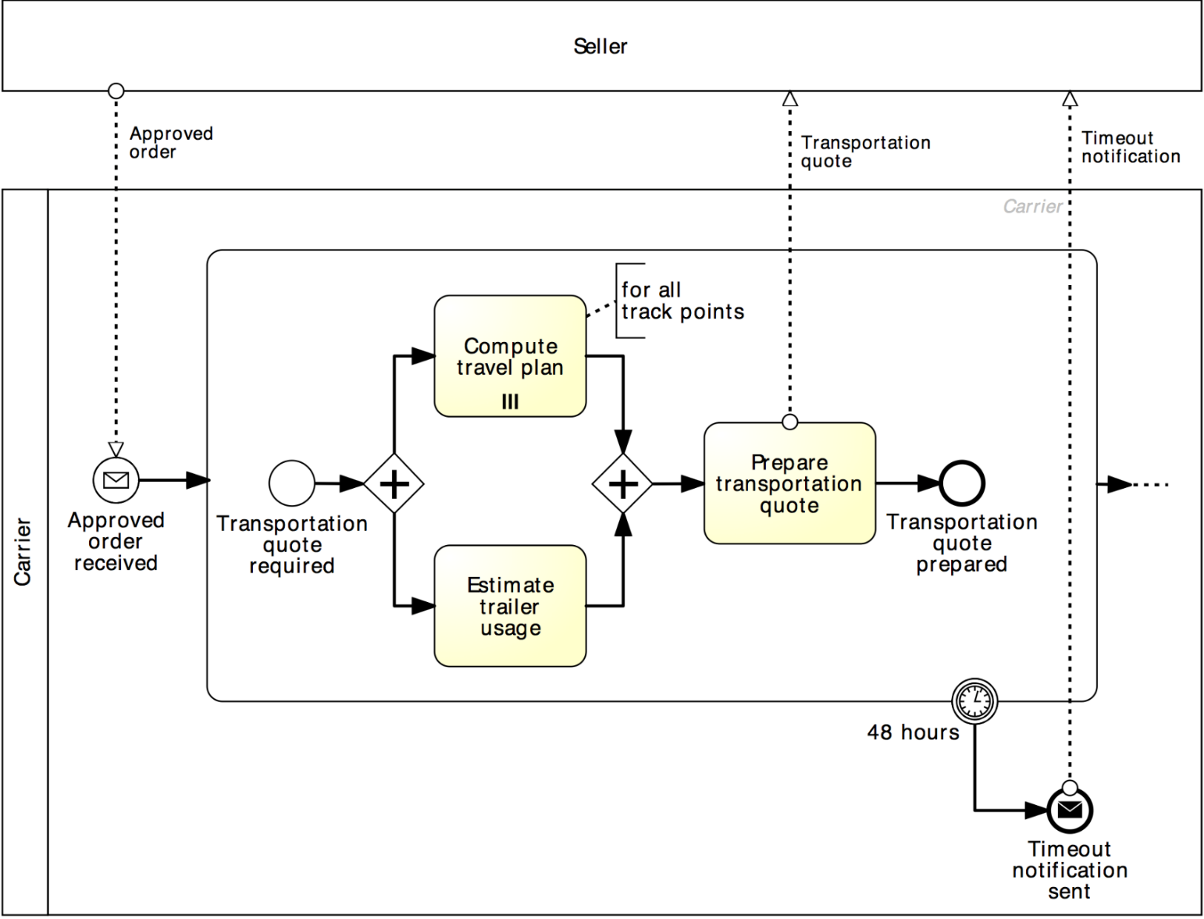
Solution: activity timeout
Order-to-transportation quote

Slide 50
More on the PO handling example…
PO handling
The customer may send a request for address change after the PO registration. When such a request is received, it is just registered, without further action.

Slide 51
Non-interrupting boundary events
Sometimes we may need to trigger an activity in parallel to the normal flow, i.e. without interrupting the normal flow.
This can be achieved by using non-interrupting boundary events
Must be attached to the activity’s boundary
Notes:
activity - A task or sub-process
Double dashed border

Slide 52
Solution: non-interrupting boundary events
PO handling

Slide 53
Summary
In this lecture we have learned about:
BPMN sub-processes
Repetition markers: loop marker and parallel multi-instance marker
Events: timer, message and error events
Event-based choice gateway
Boundary events: interrupting and non-interrupting
Error events (throw and catch)

